Slide 1
Secondary Storage

Slide 2



Meet My Team
Md.Mehedi Hasan
Shihab Al Rabby
Sumaiya Islam Lamia
ID:- 0242320005101497
Daffodil International University
ID:- 0242320005101497
Daffodil International University
ID:- 02420005101785
Daffodil International University

Slide 3
Agenda
Iintroduction of Storage Devices
Comparing RAM and Cloud Servers
Types of Secondary Storages
Best Option for Current Times.
Evaluations of Storage Devices.
Conclusion
Why not floppy disk and why SSD?
References

Slide 4

Introduction
Secondary storage is a memory that is stored external to the computer. It is mainly used for the permanent and long-term storage of programs and data. Hard Disks, CDs, DVDs, Pen/Flash drives, SSD, etc, are examples of secondary storage.

Slide 5
Types of Secondary Devices
Computer memory
Magnetic Tape
Hard Disk
Hard Disk
DVD
Floppy Disk
Solid State drive
Flash Drive

Slide 6

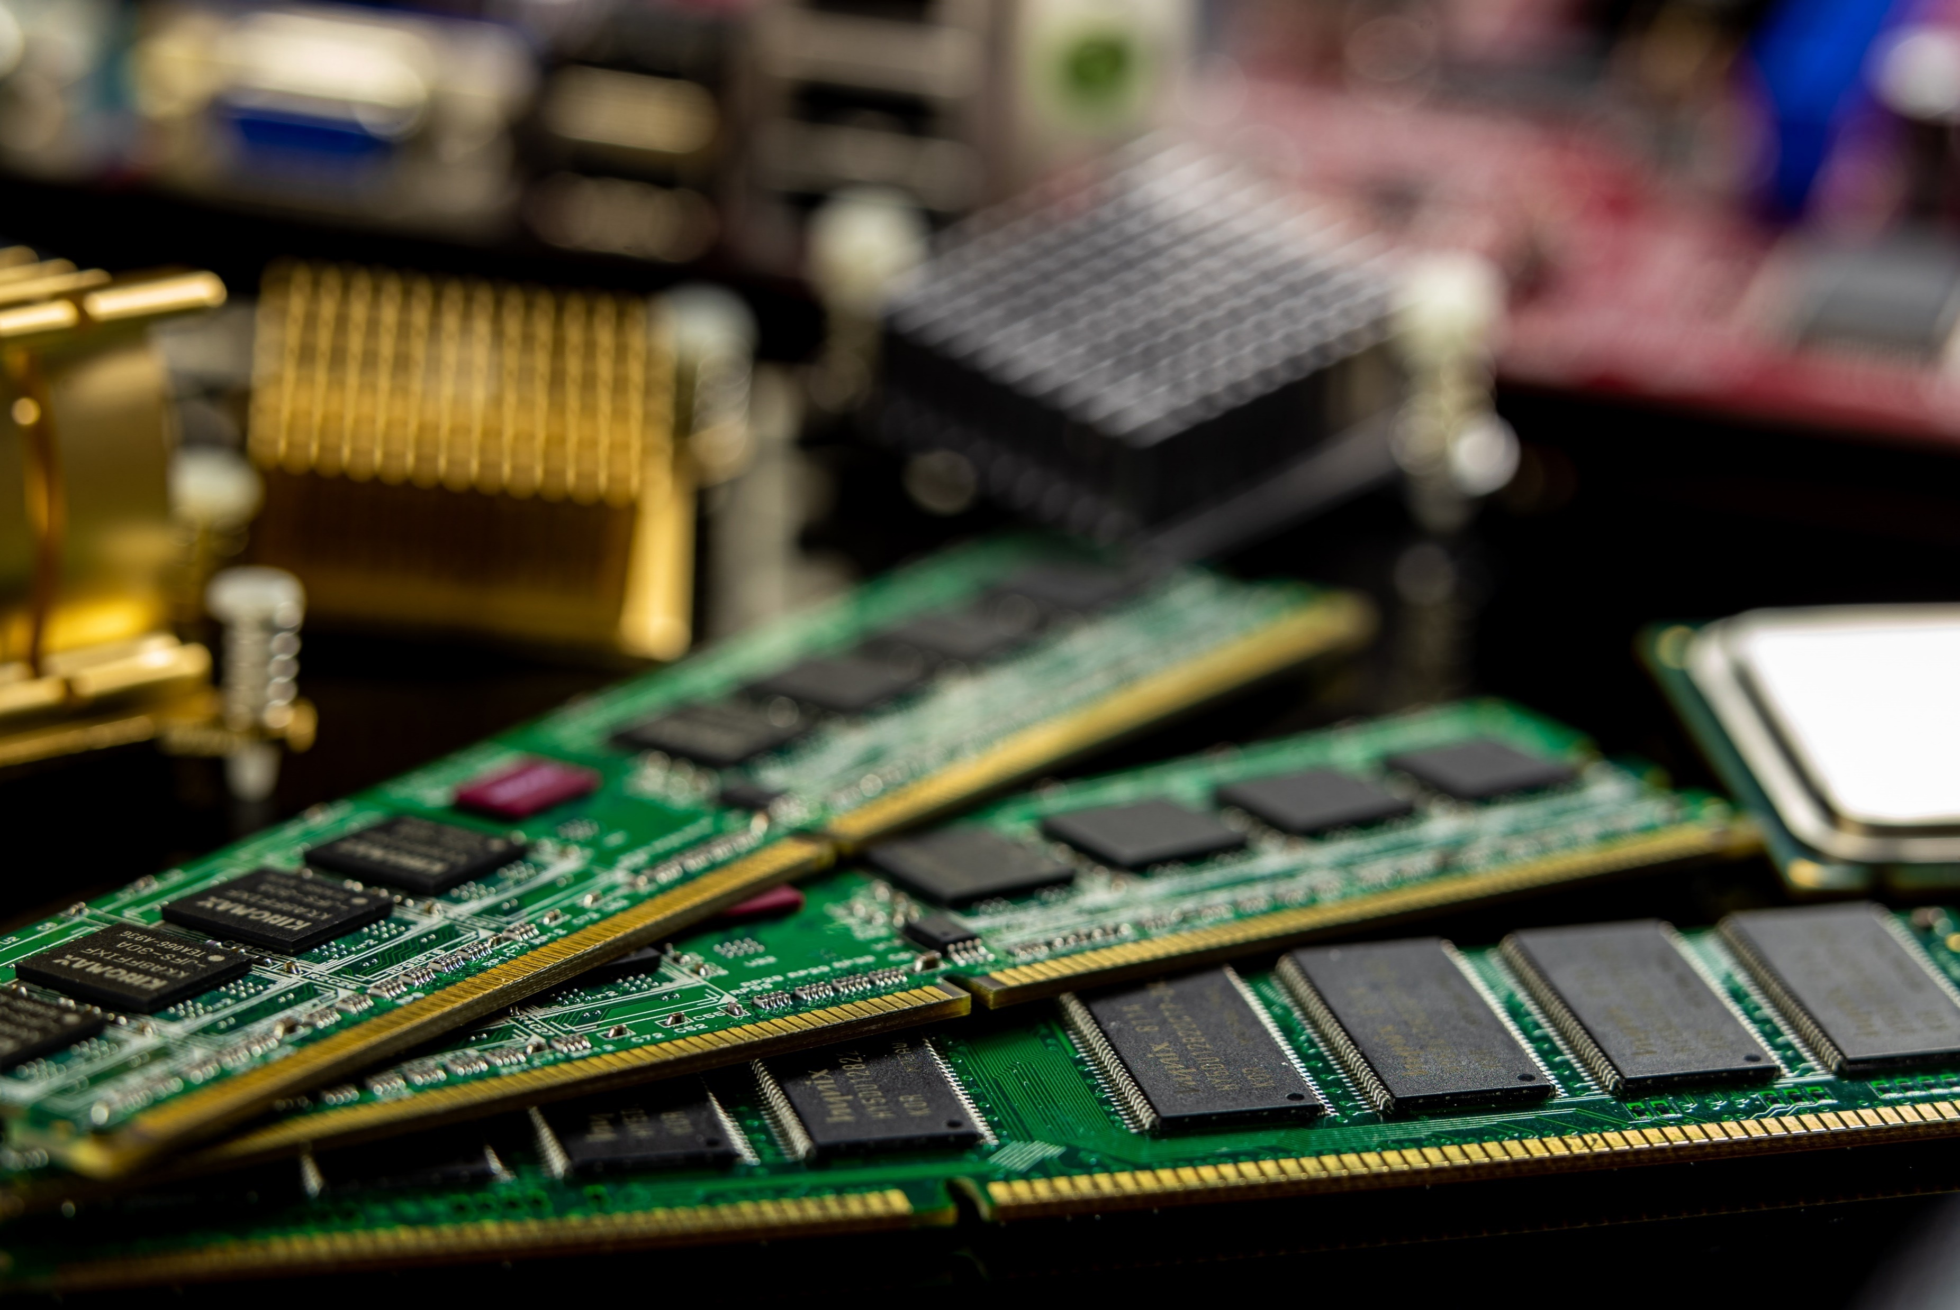
Computer memory
Computer memory
RAM
RAM is the main memory in a computer. Application programs and data in current use are kept so they can be quickly reached by the device's processor. It is much faster to read from and write to than other kinds of storage, such as a hard disk drive (HDD), solid-state drive (SSD) or optical drive.

Slide 7
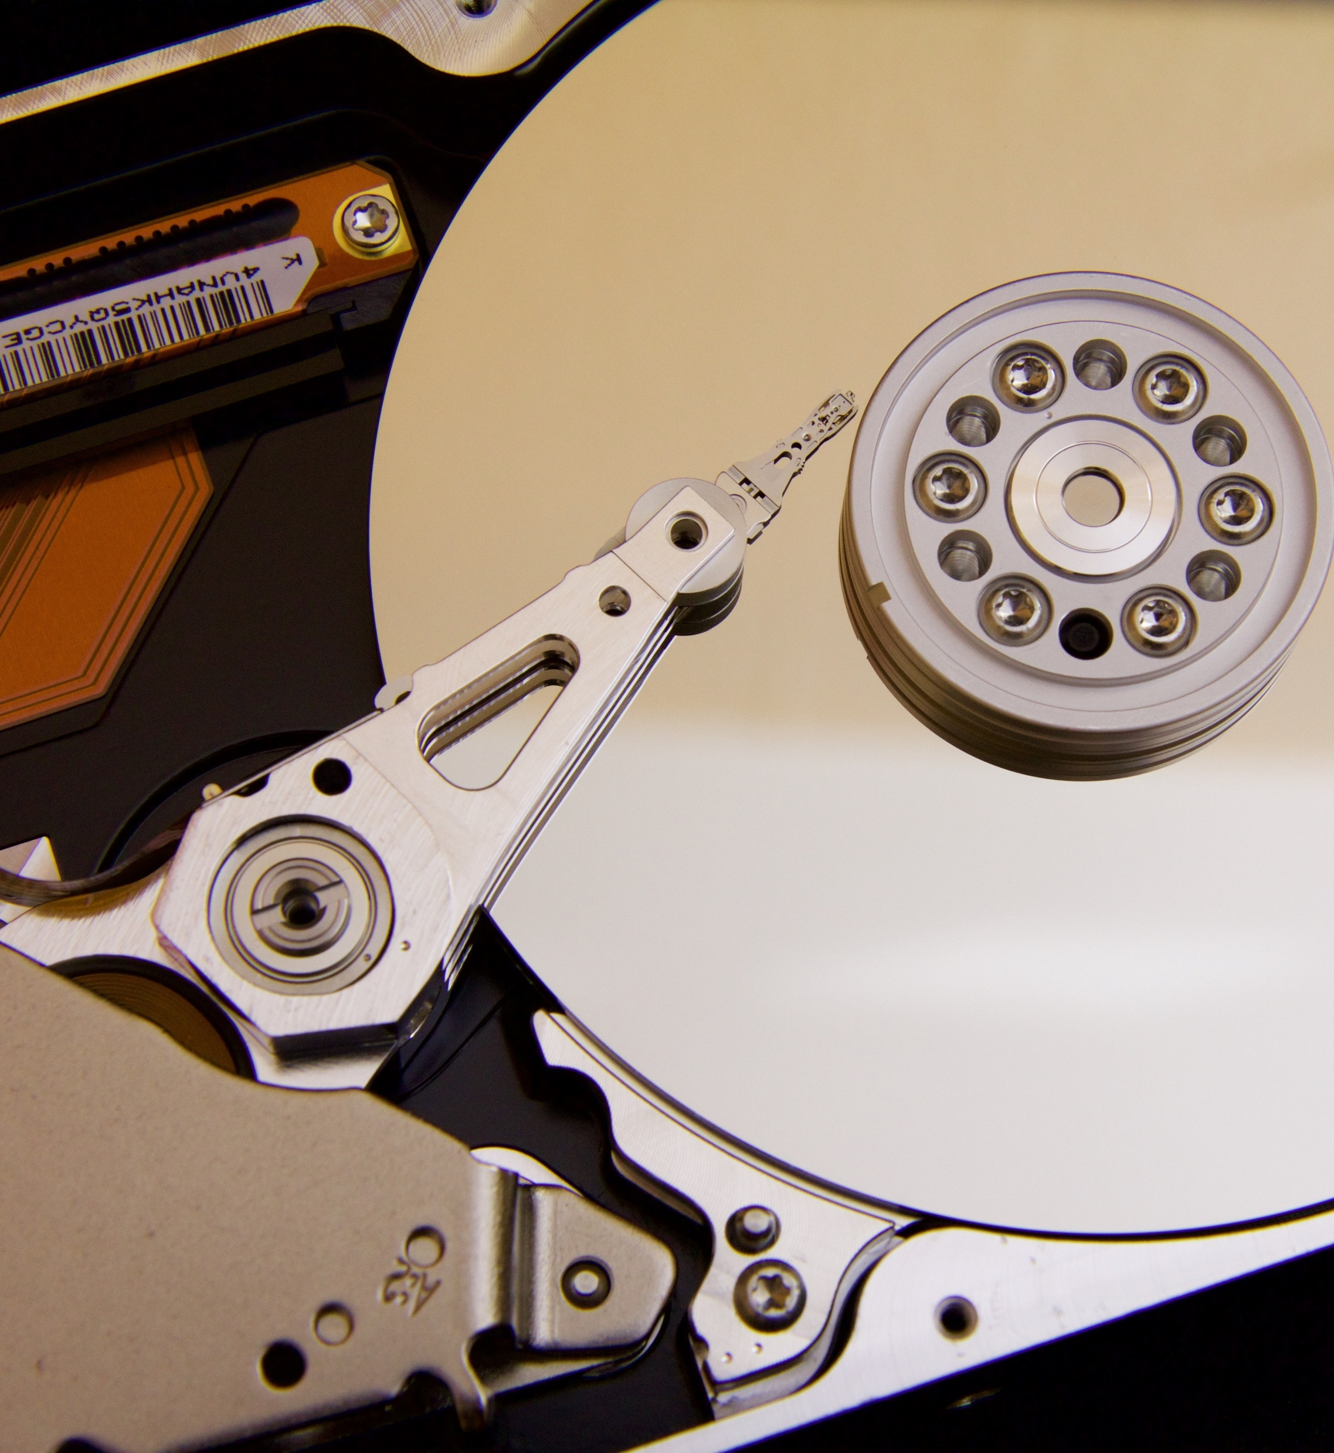
Secondary Memory
Hard Disk
Hard disk, also called hard disk drive or hard drive, magnetic storage medium for a computer. Hard disks are flat circular plates made of aluminium or glass and coated with a magnetic material. Hard disks for personal computers can store terabytes (trillions of bytes) of information. Data are stored on their surfaces in concentric tracks.

Slide 8

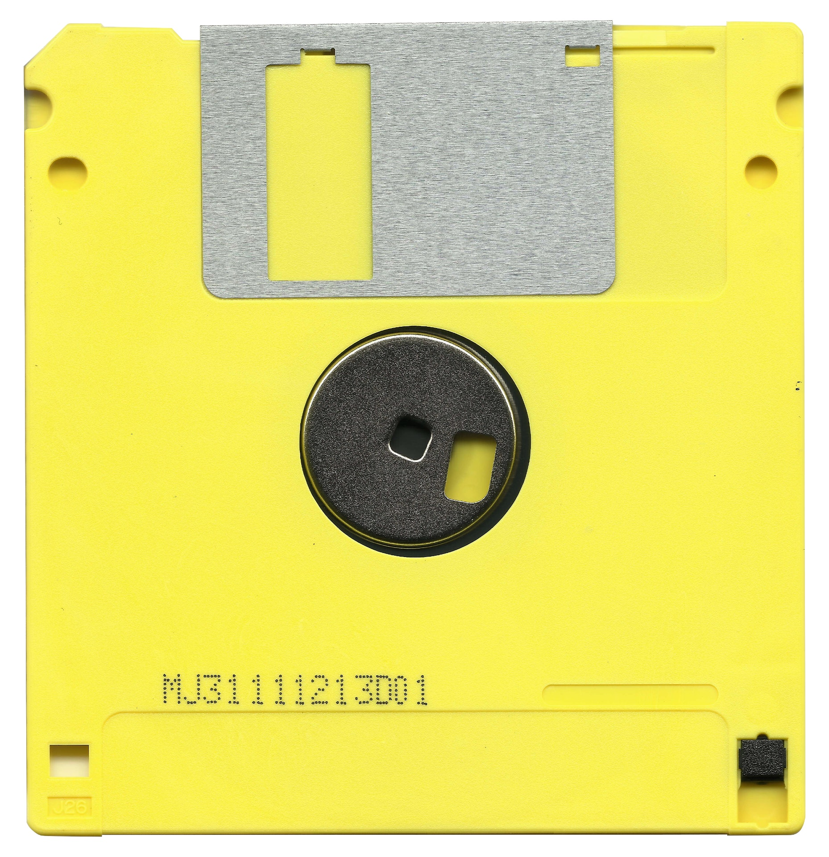
Secondary memory
Floppy disk
Legacy of floppy disk
It played a crucial role in personal computing's early days.
Stored essential files, software, and games.
A symbol of nostalgia for those who grew up with it.
Floppy disks, sometimes called flexible disks or diskettes, can store between a few hundred thousand and several million characters of information (Figures 6-17 and 6-18). It takes only about a tenth of a second for a floppy disk drive to retrieve any piece of data directly. The disk's small size and low cost (only a few dollars each) helped spawn the personal computer revolution in the late 1970s.

Slide 9
Solid State Drive(SSD)
SSDs store data permanently inside an integrated circuit, typically using flash memory. The flash memory inside an SSD means data is written, transferred, and erased electronically and silently — SSDs don’t have the moving parts found inside mechanical hard-disk drives (HDDs). Without moving parts, SSDs are fast and quiet, but they have a high price tag compared to HDDs.

Slide 10
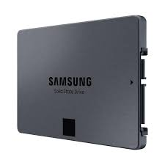
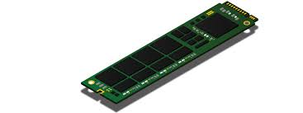
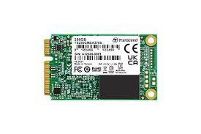
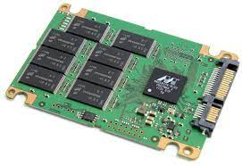
Types of SSD
SATA SSD
M.2 SSD
M Sata SSD
M.4 SSD

Slide 11
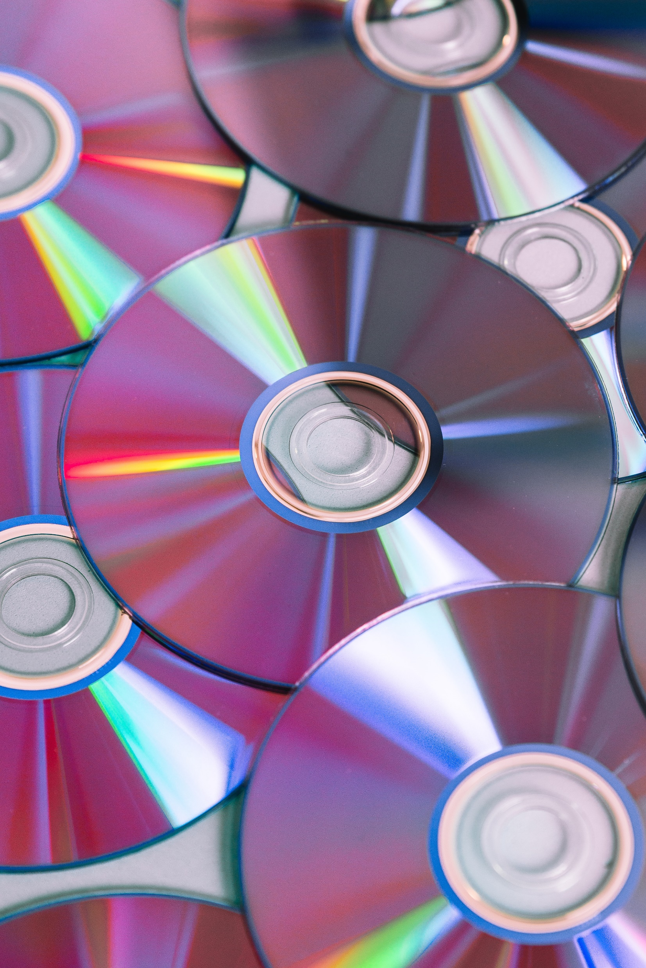
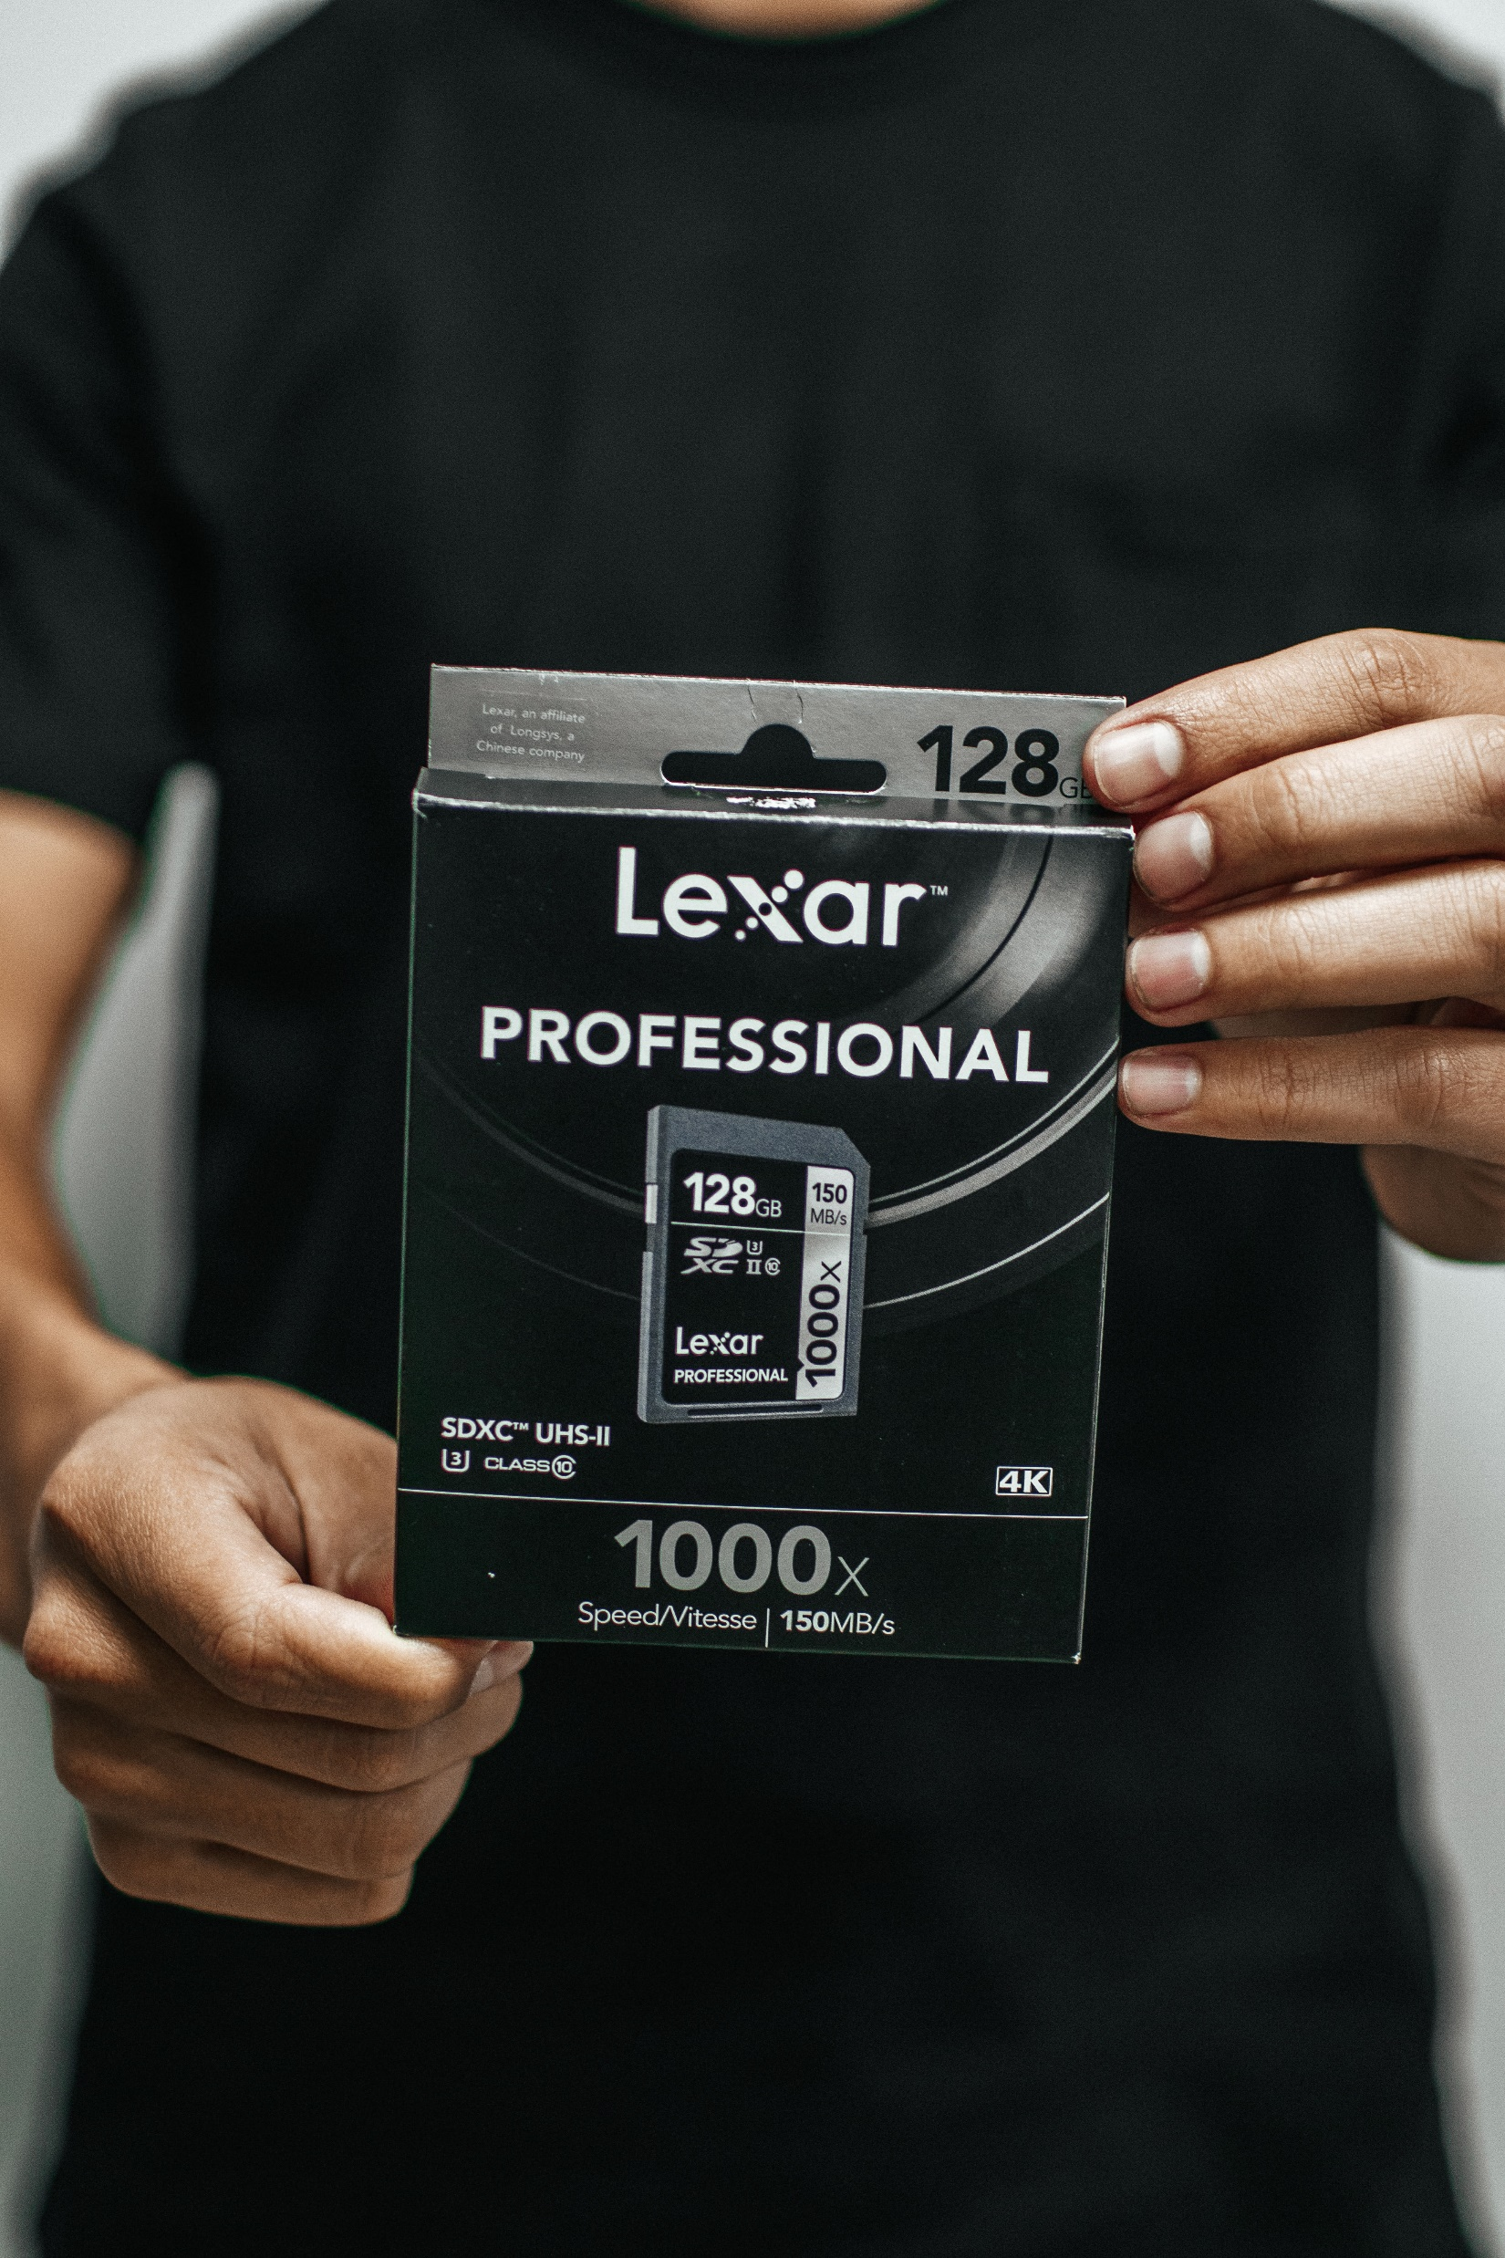
Secondary Memory
DVD & SD Card
SD card is also a small storage device.
Type Capacity
SD 2GB and under
SDHC More than 2GB, up to 32GB
SDXC More than 32GB, up to 2TB
SDUC More than 2TB, up to 128TB
DVD is a small Storage device .
A single-layer HD-DVD stores up to 15 GB of storage capacity, and a dual-layer disk provides up to 30 GB..

Slide 12
Why not floppy disk and why SSD?
Floppy Disk
Easy to be damaged
The access time of floppy disk low
They have to handle more carefully
Floppies can get affected by heat
Small storage capacity
Also limited capacity
Many new computers don't have any floppy disk drive
Data can be erased if the disk comes into contact with a magnetic field side
Slow to access and retrieve data when compared to a hard-disk device
SSD
Solid State Drive.
Speed.
Form Factor.
Lower Power.
Durability.
Support and future proof.
Noise Free.

Slide 13

Compare between RAM and Cloud Server
RAM Optimization:
1. Close unnecessary applications and processes to free up memory.
2. Upgrade RAM to increase the amount of available memory.
3. Use a memory management tool to optimize RAM usage.
4. Consider using compression techniques to reduce memory usage.
Cloud Server Optimization:
1. Use auto-scaling to dynamically adjust resources based on demand.
2. Optimize storage usage by using compression and deduplication techniques.
3. Use load balancing to distribute traffic evenly across multiple servers.
4. Monitor server performance and adjust resources as needed.

Slide 14
Resources
Information from Website
https://www.geeksforgeeks.org/what-is-a-storage-device-definition-types-examples/.
https://www.techtarget.com/searchstorage/definition/HD-DVD#:~:text=A%20standard%20single%2Dsided%2C%20one,provides%20up%20to%2030%20GB.
https://www.avast.com/c-what-is-ssd
https://www.sciencedirect.com/topics/engineering/floppy-disk
https://www.britannica.com/technology/floppy-disk
https://www.techtarget.com/searchstorage/definition/RAM-random-access-memory

Slide 15
Resources
Ai Tools
01. Canva Pro .
02. Tome.app
03. Chat GPT Vertion 3.5
04. Gogle Bird Ai.
05. All PPT Ai.
06. Wepic Ai Presentation maker.
Software And Editing
01.Microsoft Powerpoint presentation.
02.Notepad.

Slide 16
Resources
Image Resources
01. Pxels.com
02. pinteret.com
03. Canva pro
04. Microsoft Ai Photo generator
05. Freepic.com

Slide 17


Any Questions
?

Slide 18

Thank you

